Slide 1


The Sustainable Reinvention of the Internal Combustion Engine
Fuel Decarbonization and Hybrid Systems

Slide 2
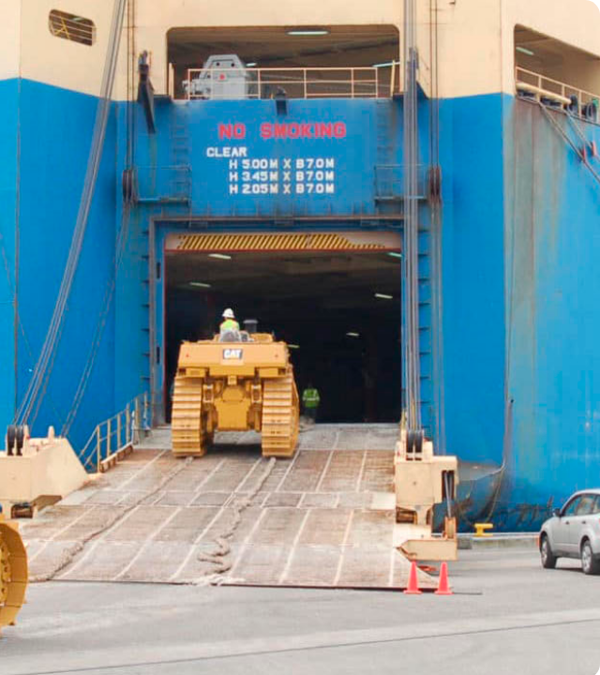
The Reality of internal combustion engines
Despite the EV revolution, the Internal Combustion Engine remains critical for global infrastructure.
Elimination of ICEs: Aviation, Marine and heavy trucking require energy densities that batteries cannot match
Current vehicles: vehicles sold today will remain on roads for decades.
The solution: Do not replace the engine; replace the fuel and optimize the system.
https://westafricaroro.com/upload/iblock/a98/a98dbec29dde8591f41498a7ccaf3baf.jpg
Source: westafricaroro.com

Slide 3
Pillar I: Sustainable Fuels
“Drop-in" solutions sourced from waste residues. Capable of up to 90% CO2 reduction immediately in existing engines.
Power-to-Liquids (PtL). Created using Green Hydrogen and Captured CO2. A truly carbon-neutral combustion cycle.
Adapting mature engine blocks to burn Hydrogen directly. Zero carbon emissions with minimal re-tooling costs.
BIOFUELS & HVO
Synthetic e-fuels
Hydrogen ICE

Slide 4
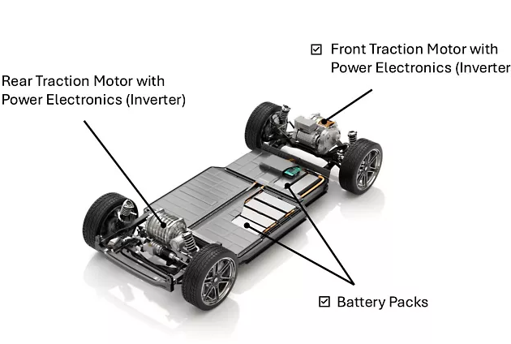
Pillar ii : hybrid Efficiency
The Efficiency Revolution
Hybridization fundamentally changes the operational profile of the ICE, addressing its inherent inefficiencies.
Optimal Load: The engine only runs in its "sweet spot" (high thermal efficiency).
Regenerative Braking: Recovering kinetic energy normally lost as heat.
Downsizing: Smaller engines doing less work, supported by electric torque.
https://images.ansys.com/is/image/ansys/ev-powertrain-diagram?wid=773&fmt=webp&op_usm=0.9,1.0,20,0&fit=constrain,0
Source: www.ansys.com

Slide 5
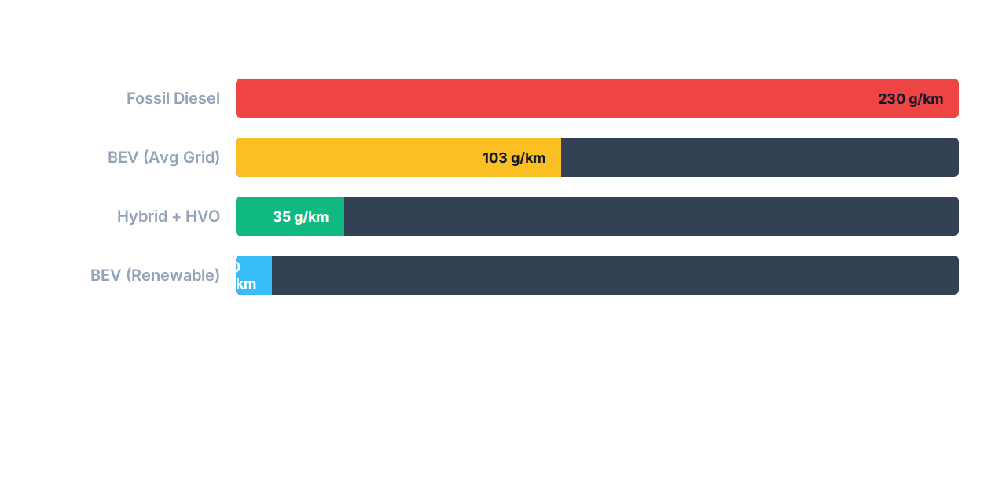
Impact: Well-to-Wheel CO2 Analysis
The future is a mixed ecosystem. By combining sustainable fuels with hybrid efficiency, the ICE becomes a partner, not an obstacle, to Net Zero.

